Slide 1
Instagram User Analytics

Slide 2
Agenda
Project Description
Approach
Tech Stack Used
Solutions & Insights

Slide 3
Project Description

Slide 4
This project will analyze Instagram user data by using SQL to find insights on how users engage and the patterns they represent. These insights will help the marketing team, product team, and investors make decisions based on data to improve user experience, start targeted campaigns, and keep the platform trustworthy.

Slide 5
Approach

Slide 6
We analyze information retrieved from tables users, photos, tags, likes, etc., of the Instagram database by using MySQL queries.
Major tasks include the search for loyal users, research on hashtags, calculation of user engagement metrics, and suspicious activity detection. Also Provide insights and trends where appropriate.
All this process will be executed and done in SQL workbench.

Slide 7
Tech Stack Used

Slide 8
IDE used is MySQL Workbench
Version – MySQL 8.0
Using MySQL because it is well suited for analysis of large datasets effectively and workbench provides an user interface in achieving query writing and debug them.

Slide 9
Solutions & Insights

Slide 10
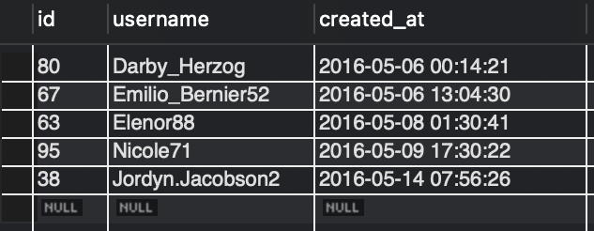
A) Marketing Analysis:
-- 1. LOYAL USER REWARD
SELECT * -- selects all column in users
FROM users
ORDER BY created_at ASC -- By default it sort in ASC
LIMIT 5; -- display 5 users using longest

Slide 11
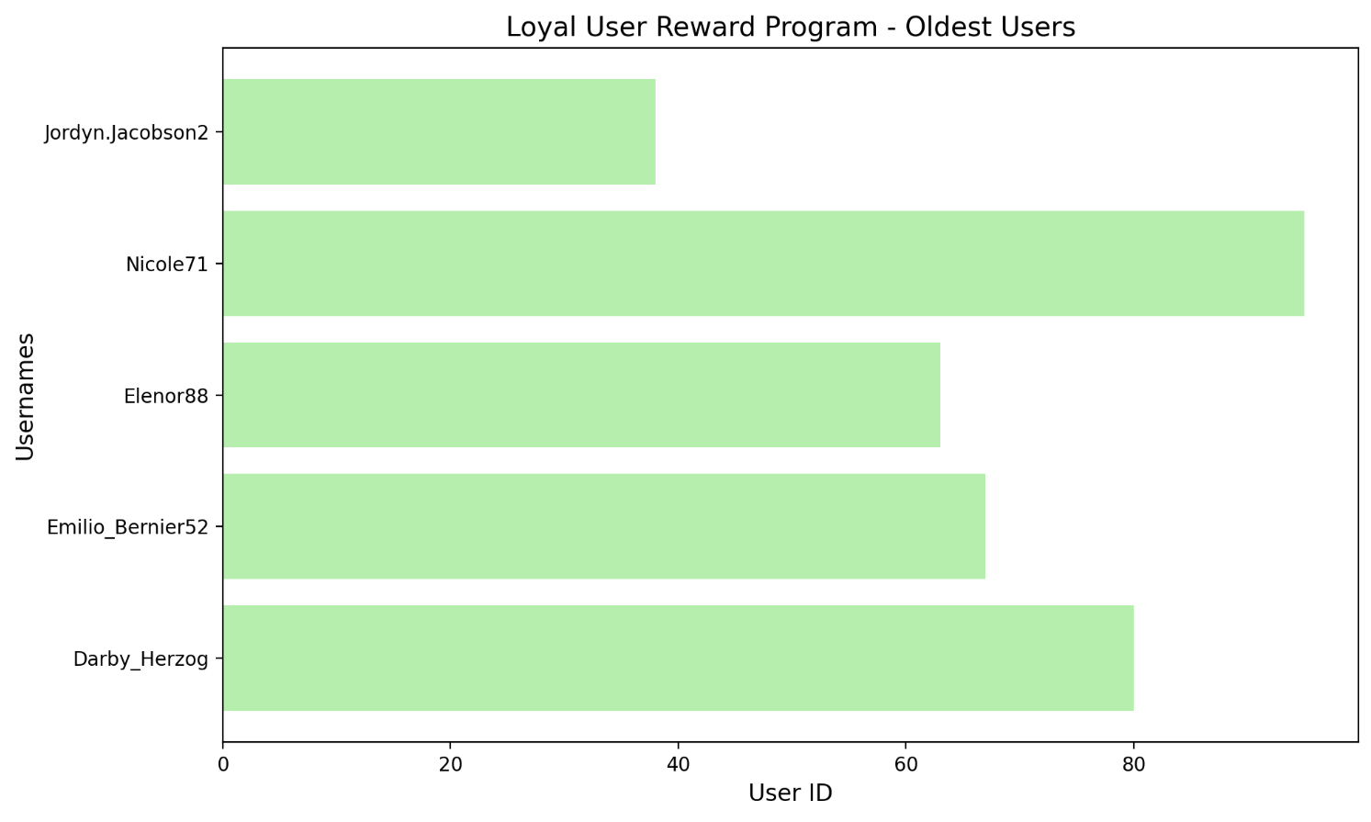
Insights - These are the five oldest users on Instagram. They can be targeted for Loyalty program and can be rewarded.

Slide 12
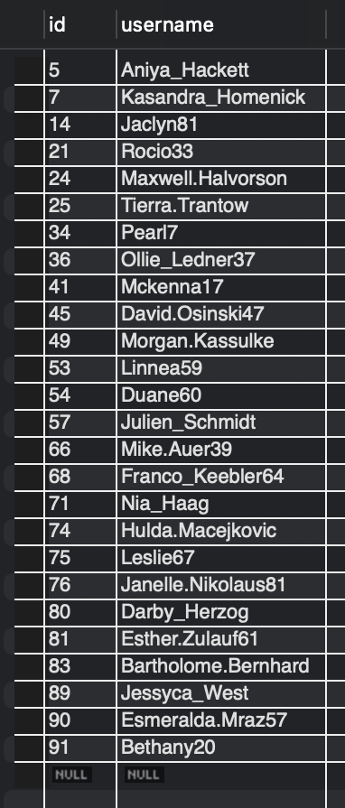
-- 2. INACTIVE USER ENGAGEMENT
SELECT u.id, u.username -- retrieve id and name from user table (we can also use *)
FROM users u
WHERE (SELECT COUNT(*) FROM photos p WHERE p.user_id = u.id) = 0; -- subquery starts execute for each user

Slide 13
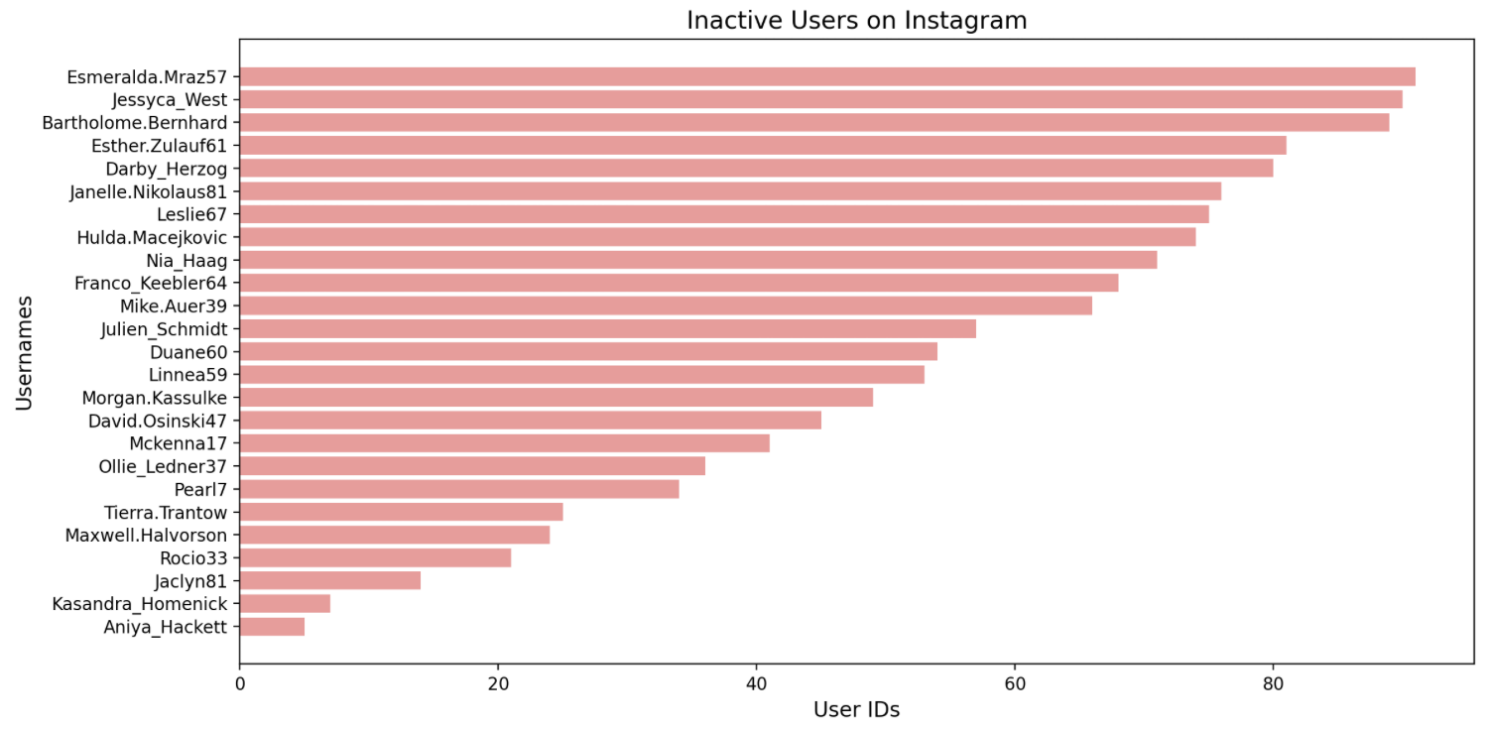
Insights – These are the users who never posted. Marketing Team can engage them with personalized email promotions to increase their activity.

Slide 14
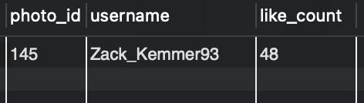
-- 3. Contest Winner Declaration
SELECT p.id AS photo_id, u.username, COUNT(l.user_id) AS like_count -- selects unique id from pics
FROM photos p
JOIN likes l ON p.id = l.photo_id JOIN users u ON p.user_id = u.id -- joins phto with likes tables using p.id
GROUP BY p.id ORDER BY like_count DESC -- groups result and performs count in decending order
LIMIT 1; -- the result limit is set to 1
Insights – Zack_Kemmer93 is the contest winner because he is the most-liked photo 48 likes.

Slide 15
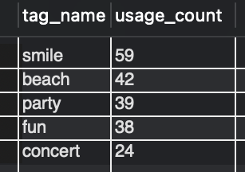
-- 4. Hashtag Research
SELECT t.tag_name, COUNT(pt.photo_id) AS usage_count -- pt phototags
FROM tags t
JOIN photo_tags pt ON t.id = pt.tag_id
GROUP BY t.tag_name -- grouping using tag name and counts no of tags used
ORDER BY usage_count DESC -- orders with allocated limit of 5
LIMIT 5;
Insights – The above five popular hashtags are listed . Where #smile and #beach are top used ones.

Slide 16
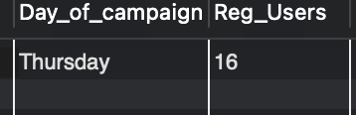
-- 5. Ad Campaign Launch
SELECT DAYNAME(created_at) AS Day_of_campaign, COUNT(id) AS Reg_Users -- DAYNAME query extracts 'name of the day'
FROM users
GROUP BY Day_of_campaign -- groups row by day in the week
ORDER BY Reg_Users DESC -- odered in desending
LIMIT 1; -- shows only one bottom result
Insights – We Observed on Thursday there is highest users registered so this would be perfect for Ad campaign

Slide 17

B) Investor Metrics:
-- 1. User Engagement
SELECT COUNT(p.id) / COUNT(DISTINCT u.id) AS Avg_posts,
COUNT(p.id) / COUNT(u.id) AS Total_photos -- counts total nmber of photos and users and takes the average
FROM users u
LEFT JOIN photos p ON u.id = p.user_id; -- joins user table with photos (to see each user is matched with posts)
Insights – Users post an average of 2.5 photos , The total photos is roughly 0.90

Slide 18
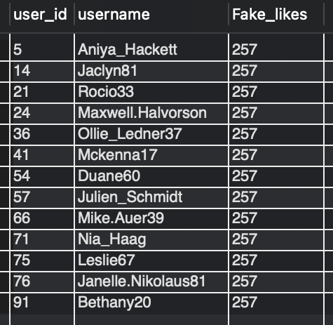
-- 2. BOTS & FAKE ACCOUNTS
SELECT l.user_id, u.username, COUNT(l.photo_id) AS Fake_likes FROM likes l -- count calculates total number of likes
JOIN users u ON l.user_id = u.id -- joins likes wit users to retrive username
GROUP BY l.user_id, u.username
HAVING COUNT(l.photo_id) = (SELECT COUNT(id) FROM photos); -- uses subquery to compare

